Slide 1

New Era Software

Slide 2
The Team
Dinolan Naidoo
Front-end Developer
Ashley Jurisich
Database Management
Kiaan Moodley
Document Master

Slide 3
Management
Democratic team dynamic
Agile management methodology

Slide 4
Our Mission
Provide businesses and individuals with information about vehicle energy alternatives that benefit both the environment and economy.
Provide a web-service that allows comparisons to be made between the user's current transport energy usage and that of the energy usage of an electrical vehicle.

Slide 5
Long Term Objectives
Solutions become integral in business practices
Less demand for petrol/diesel
Long time subscriptions from users

Slide 6
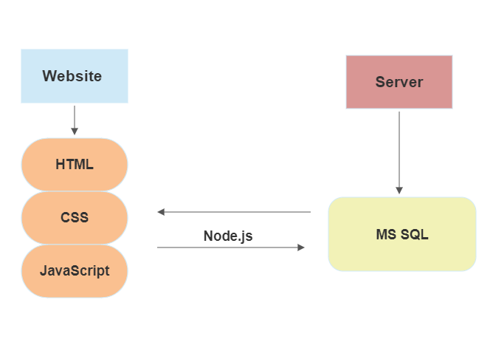
Technologies Used

Slide 7
The Website
https://dinolan-naidoo.github.io/Software_Website_Idea2/index.html

Slide 8
Functionality Testing
Navigation
Responsiveness
Visual Representation

Slide 9
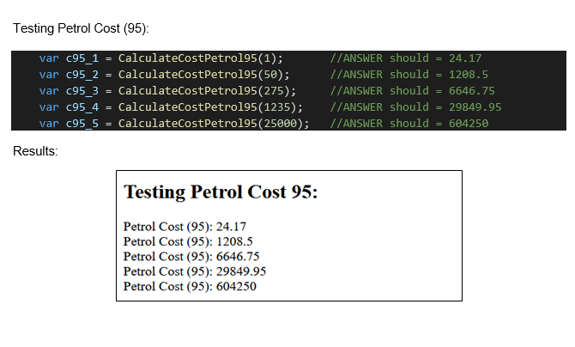
Unit Testing
Calculate Liters
Calculate petrol energy
Calculate diesel energy
Calculate petrol 95/93 cost
Calculate diesel cost
Calculate electric cost

Slide 10
Performance Testing
Page Loading time
JavaScript Functions
Visualizing results

Slide 11
Database Query Testing
Adding and Removing entries
Editing entries
Selecting entries of specific user
Sorting

Slide 12
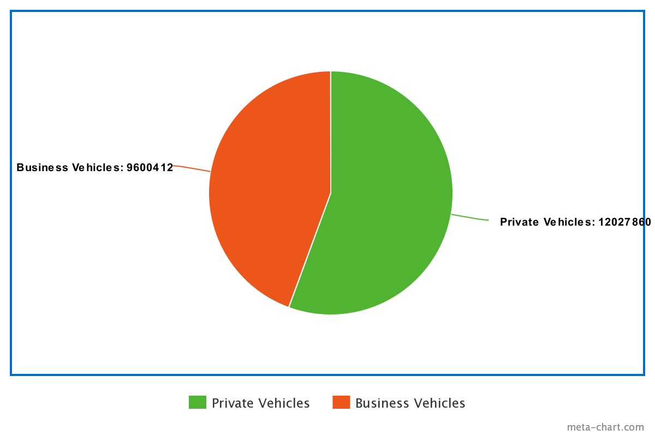
Market Analysis
Primary and Secondary Target Market
Market Segmentation
Strategy

Slide 13
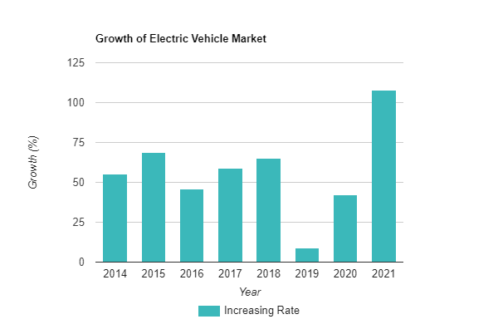
Implementation
Buying Patterns
Marketing
Sales Forecast

Slide 14
Budgetary Considerations
Start-Up Capital required: R46 036.00
3 Inexperienced Software Developers, starting salary: R720 000.000 per year
Cloudflare Server Hosting Services: R37 389.12 a year
= R803435.12, Seeking around R1 000 000 in investment. Room for error and additional costs.

Slide 15
Thank You
Q & A

